Slide 1
Inclusion for All
Caring Hands
Fall 2018

Slide 2
Mindfulness Exercise
_________________________________________________________________
Social Emotional Learning .
Notes:
People can do this with eyes open or closed, and they may use one hand or both hands. Start with the thumb on the index finger. As you inhale, slide the the thumb toward the tip and squeeze. As you exhale, slide the thumb back down the index finger. With the next breath, move on to the middle finger. You can continue this practice to the pinky finger, then move back toward the index finger. This is a great way to engage with mindfulness, as we are breathing mindfully but using the additional experience of the finger-touching to help us concentrate.
Close your eyes. Allow yourself to get comfortable. …. Begin with a few slow deep breaths in through your nose and out through your mouth, letting your body get relaxed. Let the chair fully support your body as you continue to breath and relax. Now, use your imagination to picture yourself walking slowly along a path. It’s a pleasant path, any kind that you wish. It’s a beautiful day, and you feel relaxed and happy. You can feel the warmth and energy of the sunlight on your skin. …… Soon you come to a gate. You know this gate leads to a special place where you feel welcomed, safe, and comfortable. Push the gate open and allow yourself to enter your very own private garden. Your garden is filled with your favorite things. Whatever is pleasing to you can be found in this place. Perhaps there are flowers, trees, animals, birds, water, or even music. Look around and notice what is in your garden. ….. See all the colors and objects that are in this place. Notice how beautiful they are. …. Look at the various shapes and see how varied they are…. Look at the ground, look at the sky, and see where they meet. …. Your garden is calm and tranquil. Everything peacefully co-exists in the garden. …… As you are looking, become aware of how things might feel in this private place of yours. explore this place with your sense of touch.
Perhaps some things are soft and warm, and others are smooth and cool. Simply spend some time exploring, using your sense of touch as you continue to feel at peace and comfortable. …. Notice what the air feels like; is it cool or warm? … Is there a breeze or is it still? … Take the time to feel the peace and serenity in this private place. ….. As you continue to explore your garden by seeing and feeling, become aware of the sounds that you hear in your garden…. The sounds in your garden are pleasing to the ear and very comforting. Perhaps it is quiet in your garden, or maybe there are a number of sounds. Some of the sounds may be very soft, while others may be louder. Relax and listen for a while and see if you can identify the different sounds in your garden. ….. As you’re listening to the sounds in your garden, become aware of what smells you might smell. Take a deep breath in, and notice the fragrances that are present. Some of them may be familiar, while others may be unfamiliar. The fragrances are pleasant and soothing. ….. Take your time and enjoy your visit to the garden, using it in whatever way that you wish. Spend the time that is necessary for you to rejuvenate and to care for yourself……… When you are ready to leave, slowly walk back towards the gate of your garden. You have enjoyed your visit to the garden and feel relaxed and content. This good feeling will remain with you throughout the day. Push the gate open and return to the path that led you to the garden. As you make your way back up the path to the here and now, remember that you can use your imagination to return to your private garden at any time you wish. Visit your garden any time you would like to relax, to be comforted, or just to enjoy its beauty. ….. You are now ready to resume your day. Stretch gently and open your eyes, feeling refreshed and alert.

Slide 3
What We Will Cover
Background on CYSHCN
Other Community Supports
Social Emotional Learning
ADA
Seclusion and Restraint
Partnering with School Districts (IDEA)
Inclusion Strategies and Supports

Slide 4
Who We Serve
_________________________________________________________________
Wisconsin uses the federal definition as:
"...those who have or are at increased risk for a chronic physical, developmental, behavioral, or emotional condition and who also require health and related services of a type or amount beyond that required by children generally."

Slide 5
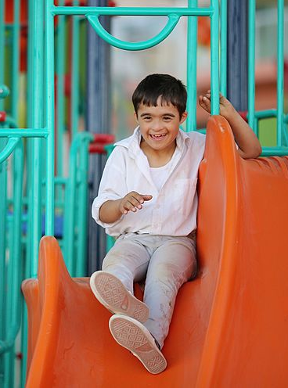

250,000 WI children have a special health care need
That’s 2 out of every 10 Wisconsin children
Source: National Survey of Children’s Health – 2016 available at: http://www.childhealthdata.org

Slide 6

Of those 250,000 WI children with a special health need….
4 out of 10 children with inadequate insurance coverage
3 out of 10 non-CSHCN children with inadequate insurance coverage
2 out of 10 children had out of pocket health care costs between $1000-$5000 in the past year
Less than 1.4 out of 10 non-CSHCN paid this much in out of packet costs
Source: National Survey of Children’s Health – 2016 available at: http://www.childhealthdata.org

Slide 7
Of those 250,000 WI children with a special health need….
3 out of 10 children did not receive the care coordination they needed
3 out of 10 children received 1+ hrs each week of health care at home from family members
Nearly 2 out of 10 children needed their family members to spend 1+ hrs each week arranging/ coordinating their medical care
Source: 2016 National Survey of Children’s Health

Slide 8
Of those 250,000 WI children with a special health need….
2 out of 10 children ages 6-17 yrs missed 6-10 days of school
Only 1.3 out of 10 non-CSHCN children missed this much school
1 out of 10 children ages 6-17 yrs missed 6-10 days of school
Less than 0.5 out of 10 non-CSHCN children missed this much school
Source: National Survey of Children’s Health – 2016 available at: http://www.childhealthdata.org

Slide 9
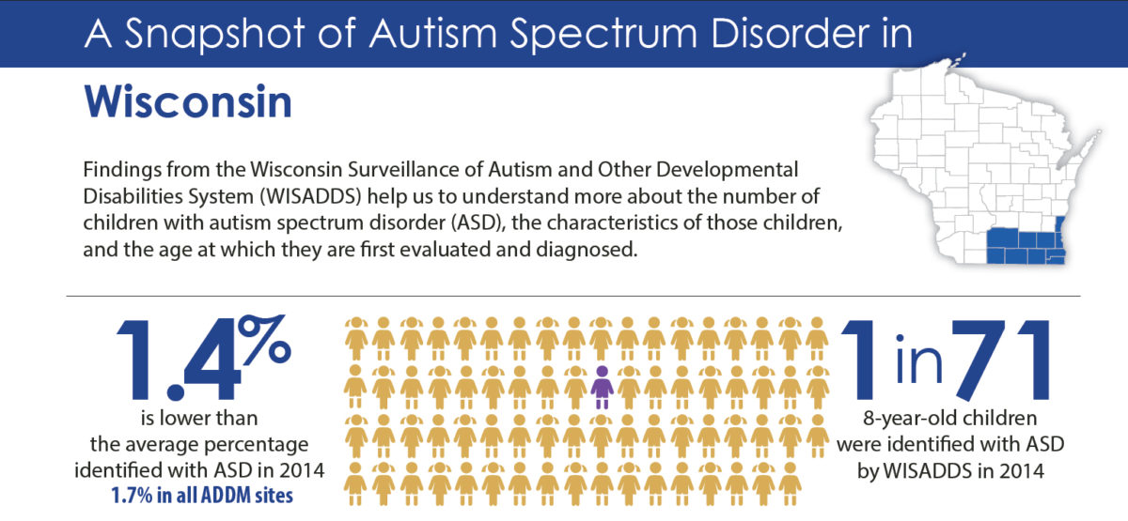
In Wisconsin…
1.4% of children or
Source: A Snapshot of Autism Spectrum Disorder in Wisconsin available at: https://www.waisman.wisc.edu/2018/04/30/new-cdc-report-finds-increasing-prevalence-of-autism-in-school-age-children/

Slide 10
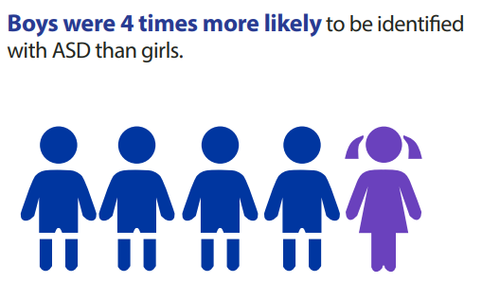

Source: ADDM Community Report on Autism 2018 available at: https://www.cdc.gov/ncbddd/autism/addm-community-report/documents/addm-community-report-2018-h.pdf
This is national level data. WI stats are boys are 3.4 times more likely than girls
Notes:
This is national level data. WI stats are boys are 3.4 times more likely than girls

Slide 11
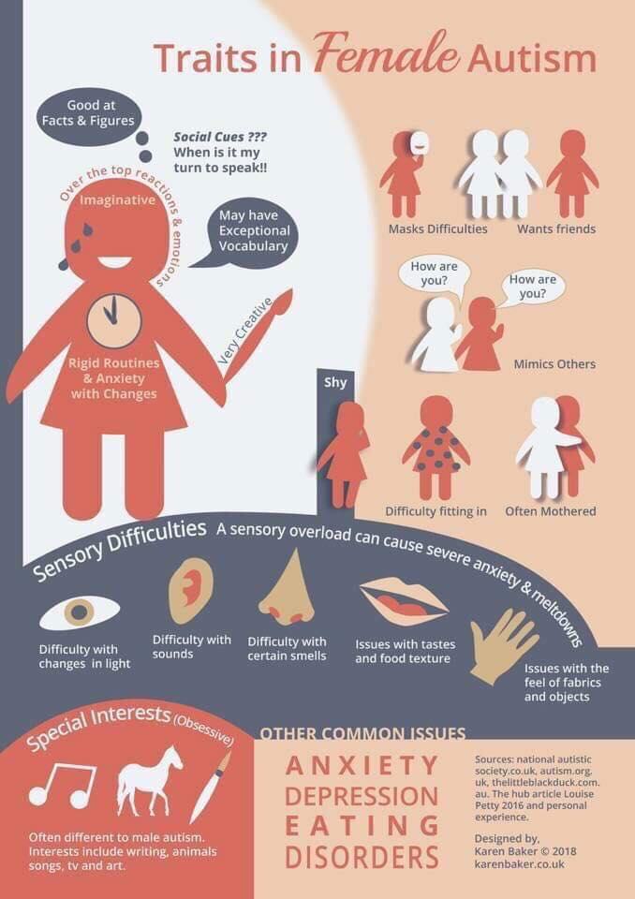

Slide 12

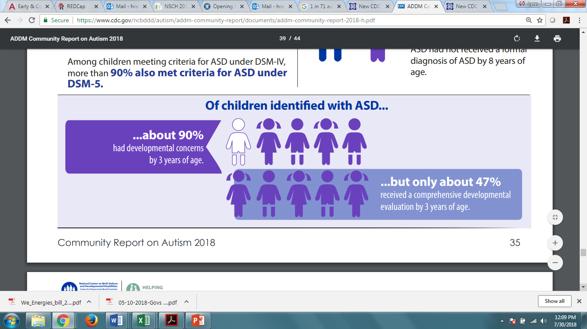
We can do better!
Even though an ASD diagnosis as early as 2 years of age can be valid, reliable and stable, most children were not diagnosed with ASD by a community provider until after 4 years of age.
Source: A Snapshot of Autism Spectrum Disorder in Wisconsin available at: https://www.waisman.wisc.edu/2018/04/30/new-cdc-report-finds-increasing-prevalence-of-autism-in-school-age-children/

Slide 13
Examples of Conditions Include: _______________________________________________________________________
ADHD
Asthma
Autism
Behavioral/Emotional
Cerebral Palsy
Developmental
Delays
Diabetes
Epilepsy

Slide 14
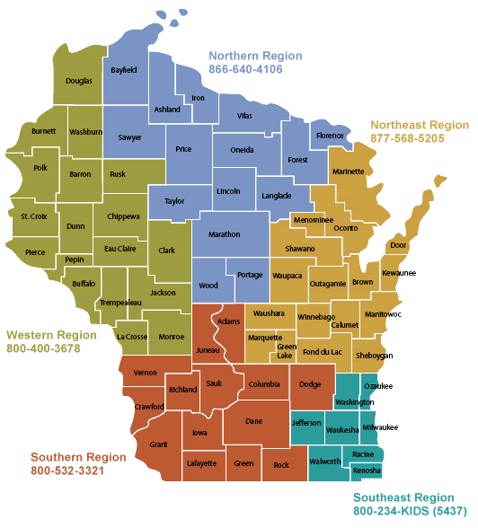


Five Regional Centers
Notes:
There are five regional centers that are part of the Children and Youth with Special Health Care Needs network. I [we] represent the ______________ Regional Center.
{go to your Regional Center specific slide, either delete or hide the other regional center slides}
Talking Points
Five Regional Centers

Slide 15
Why Families Call
_________________________________________________________________
Access to Information
Health Benefits Questions
Care Coordination Needs
Education Related Concerns
Parent Support
Family and Youth Leadership
Transportation
Help with Transition and Medical Home

Slide 16
Medicaid Services to Help Your Families _______________________________________________________________________
Families may have Medicaid/Forward Health card as primary health insurance.
They may receive Medicaid through BadgerCare (financially based), Katie Beckett Medicaid (based on needs of the child), or SSI (based on finances and needs of the child).
Families may also have private health insurance and Medicaid as secondary insurance
Gas money for doctor’s appointments, incontinence supplies for kids age >4, co-pays for doctor’s visits and prescriptions

Slide 17
Health Care Coverage
Private Insurance
Through an employer
Purchased through the Marketplace
Public Benefits for Health Care
BadgerCare
Katie Beckett
Disability Medicaid with SSI

Slide 18
Long Term Care Programs
Children’s Long Term Support Home and Community-Based Medicaid Waivers
Administered by the County Human Services
3 areas of disability eligibility
Physical
Developmental
Severe Emotional Disturbances
Meet level of care criteria
Medicaid recipient
Children’s Community Options Program

Slide 19
Wisconsin Affiliates
Support Groups
Families, Mom, Dads, Adults, Teens
Resource Guides
Events
Workshops

Slide 20
Some ways to think about Inclusion
Do you have books and play that include disability

Slide 21
Inclusion
IFSP
IEP

Slide 22
An inclusive attitude holds that children teach us what might help them when we are willing to notice their attention and demeanor.
It is always worth wondering what the child’s perspective might be before making teaching decisions.
UNDERSTANDING BEHAVIOR - Why is s/he doing that?

Slide 23
Social Emotional Learning
Pyramid Model
Breathing Exercises
Inhale the Flower, Blow out the candle
Star Breathing

Slide 24
Americans with Disabilities Act
Programmatic and Physical Access
Undue Burden
Reasonable
Direct Threat
Scenario:

Slide 25
Seclusion and Restraint
Seclusion and Restraint are terms used regarding when children
https://dpi.wi.gov/sped/topics/seclusion-restraint/faq
http://www.disabilityrightswi.org/resources/misuse-of-seclusion-and-restraint/

Slide 26
Strategies & Support
What do initial conversations with parents include?
Information that is usable and sensible
Information that impacts the classroom is usable, diagnosis not necessarily
What information would be helpful for us to know in order for us to best care for your child?
Starting with Page 6 in A Thinking Guide to Inclusive Childcare

Slide 27
Strategies & Support
Does your center provide programming around inclusion/ disability awareness?
Do you have strategies that promote disability inclusion?

Slide 28
Strategies & Support

Slide 29
Scenarios
We have a child in our 3 yr old classroom who is struggling. It is difficult for her to play with others, she frequently does not take naps, and does not sit down for circle time. I have tried to talk to the parents a few times.

Slide 30
Scenarios
We have a 4 year old who also receives services through the school or a therapist (I am not sure) and his parents mention that they would like for us to implement some of the things they do in that program but it is unclear how to do these therapies. Can I call the school and ask?

Slide 31
Scenarios
There is a young boy whose parents tell us to

Slide 32
Thank you!
Go and do amazing things!

Slide 33

Acknowledgement
________________________________________________________________
Funded in part by the MCH Title V Services Block Grant, Maternal and Child Health Bureau, Health Resources and Services Administration, U.S. Department of Health and Human Services.

